Slide 1
Herbold Meckesheim

Slide 2
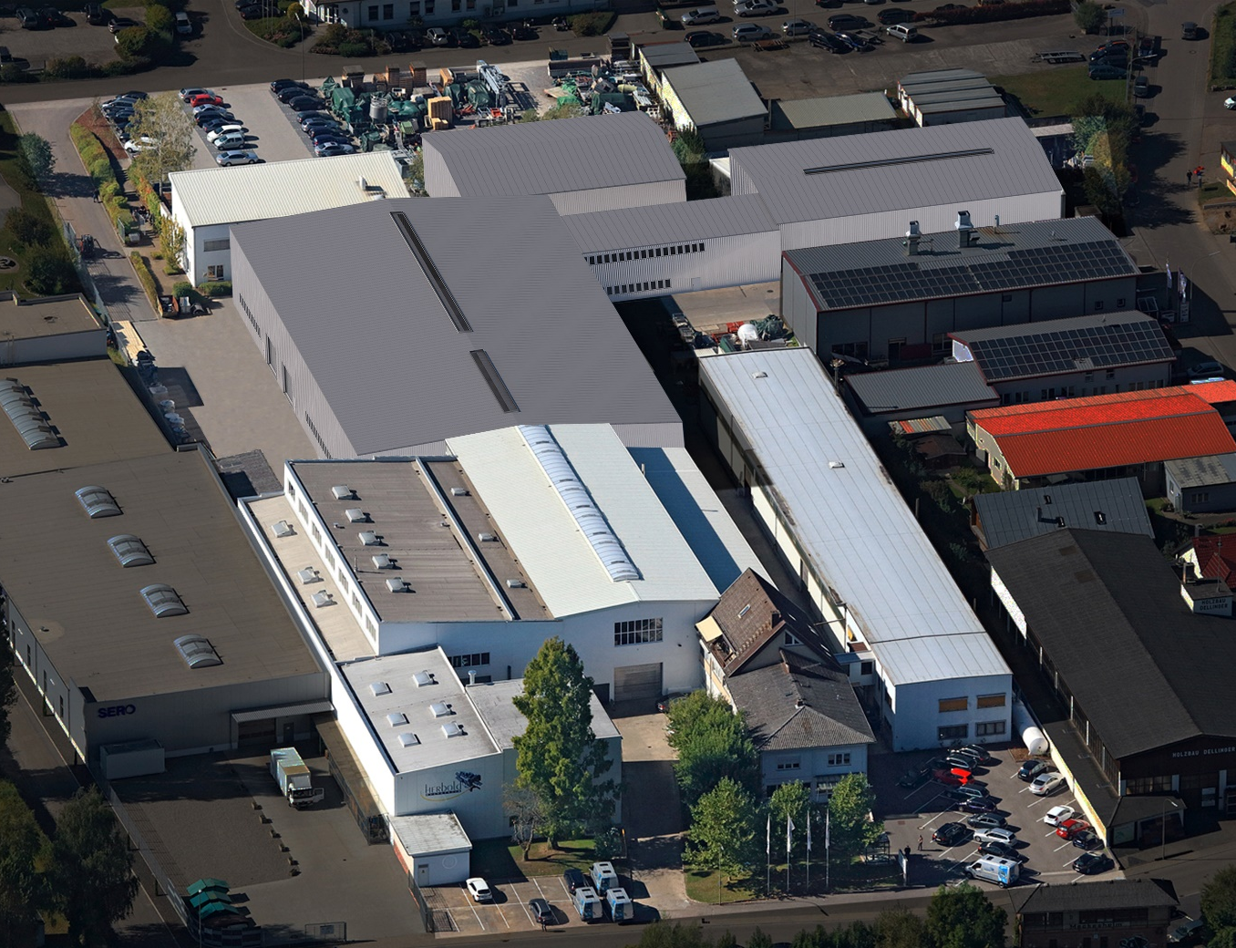
HERBOLD Meckesheim GmbH Your partner for plastics recycling
Since 1978 HERBOLD Meckesheim has predominately focused on plastics recycling; supplying more than 5.000 granulators with motor sizes larger than 45 kW and more than 300 washing lines for post-commercial, post-industrial, contaminated, and mixed plastic waste.
Our team of 170 employees and personnel from our worldwide commercial agencies will accompany the machines we supply all the way from commissioning to the end of their service lives.
Our annual turnover amounts to ~30€ million. Our Meckesheim production plant covers an area of 10.000 m².
We operate a modern test facility for testing our machines with customer-specific materials.
HERBOLD offers industrial standard on 10.000 square metres.

Slide 3
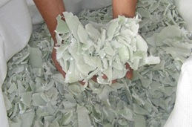
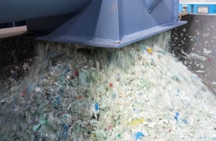
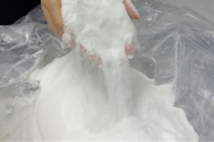
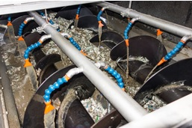
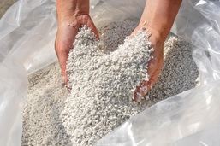
HERBOLD Product range
HERBOLD offers an extensive self-designed product range taking into consideration the 5 columns of plastics recycling and can supply a one-stop washing line.
Shredding
Granulation
Pulverizing
Washing, separating & drying
Agglomeration

Slide 4
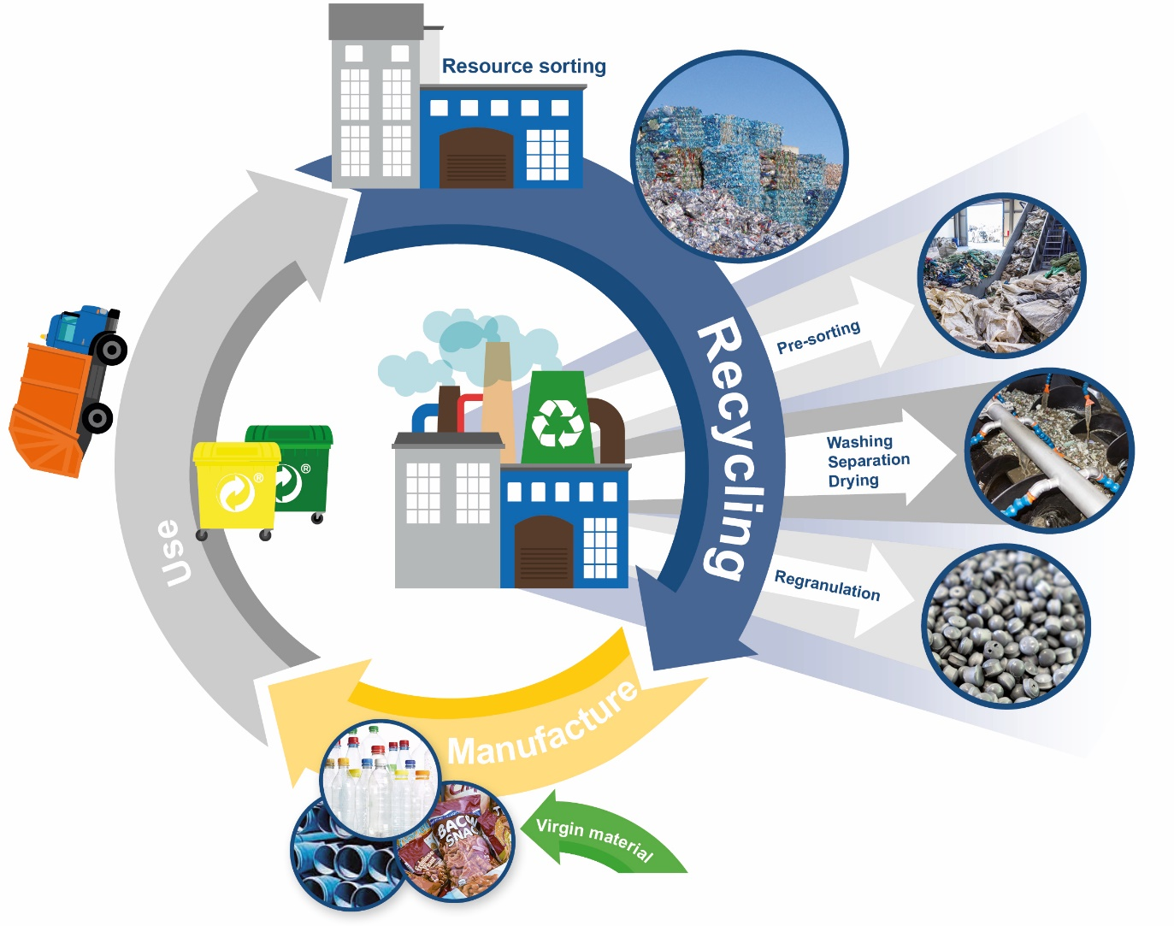
HERBOLD Plastic recycling loop – post consumer
EU Legislation
Plastic Recycling target: 63%
„plastic tax“ by 2021
more collection
more sorting
more washing
High quality recycling
Replacing virgin plastic

Slide 5
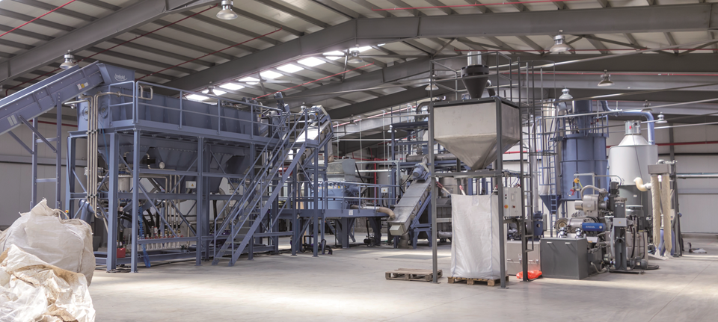
Washing line for plastic waste

Slide 6
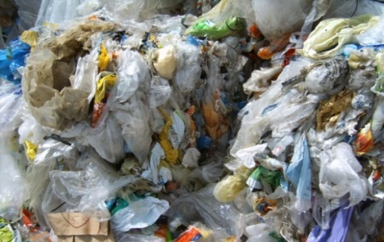
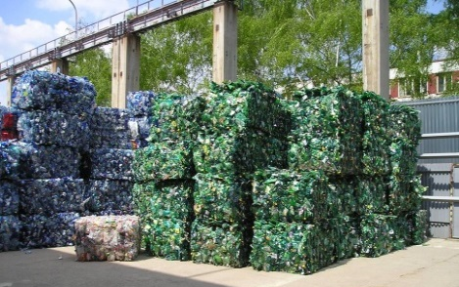
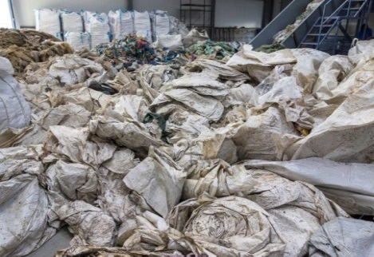
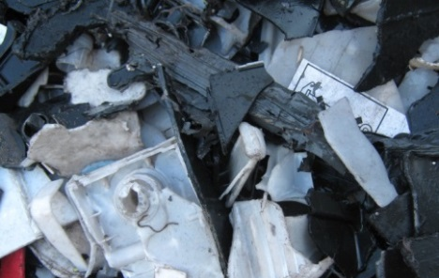
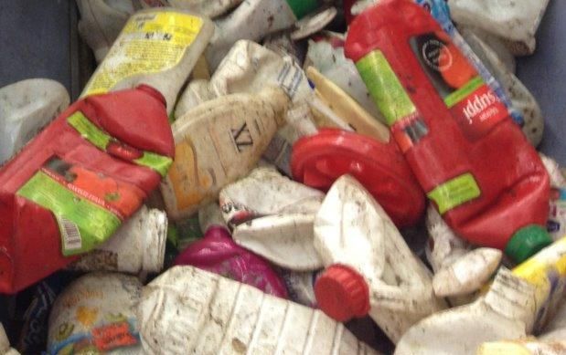
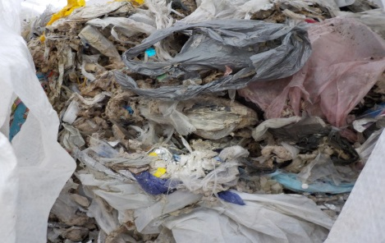
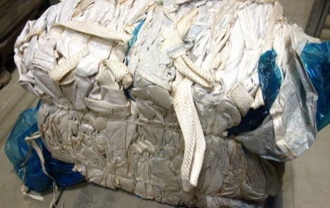
State of art - Washing technology
Applications
Post-consumer film
PET-Bottles
Agricultural film
Car battery cases
Post-consumer HPDE/PP waste
Pulper / Tetrapak waste
Post-consumer BigBags

Slide 7
HDPE-Bottles (Hard Plastics) Washing Line

Slide 8
PO-Film Washing Line

Slide 9
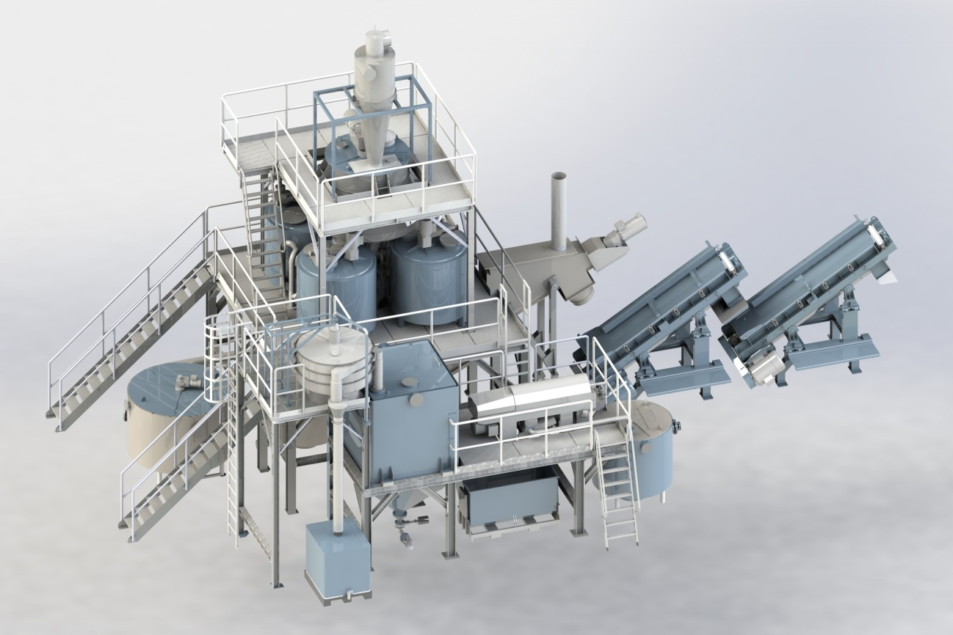
Hot-wash step: Overview
60 - 85°C - glue, fat, organic, paper separation
^{Hot Wash}
^{buffer unit}
^{Friction} ^{washer}
^{Hot Wash}
^{Agitating tank (4 Tanks)}

Slide 10
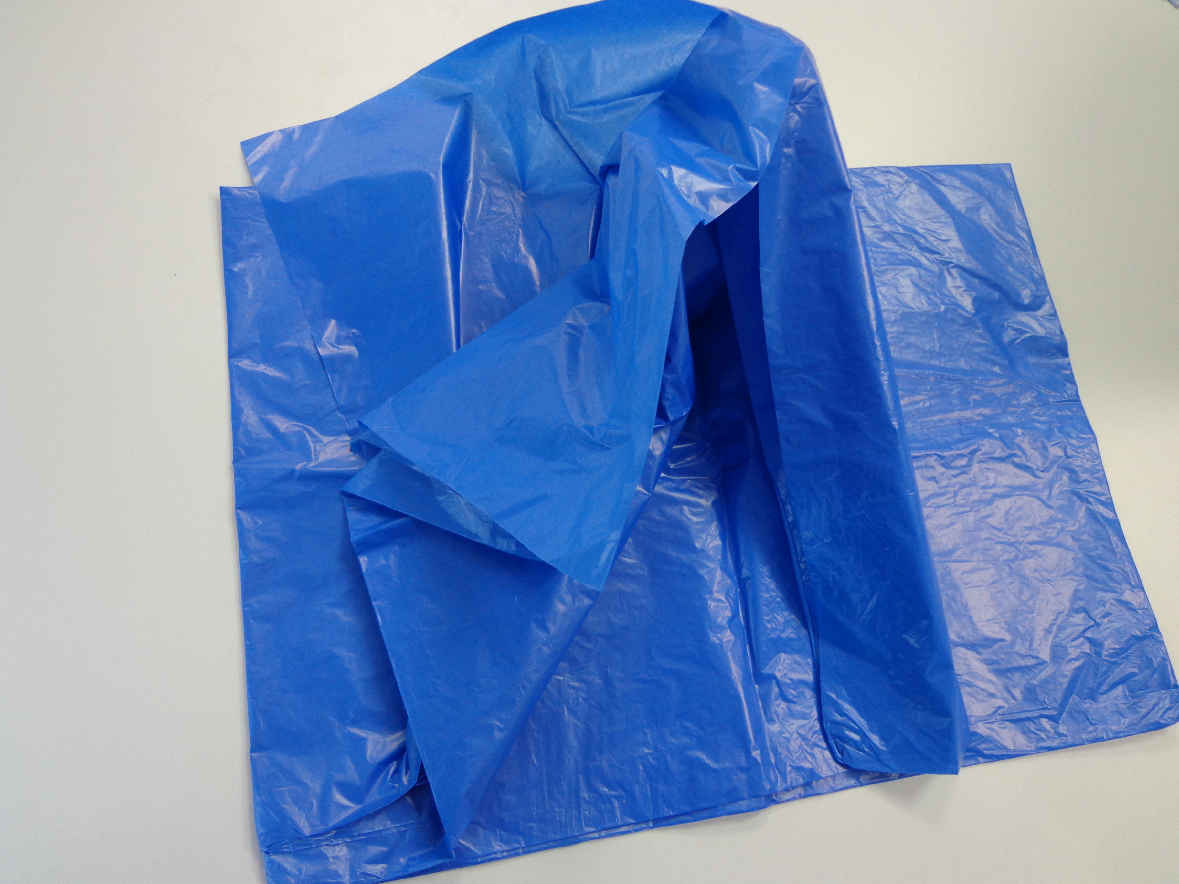
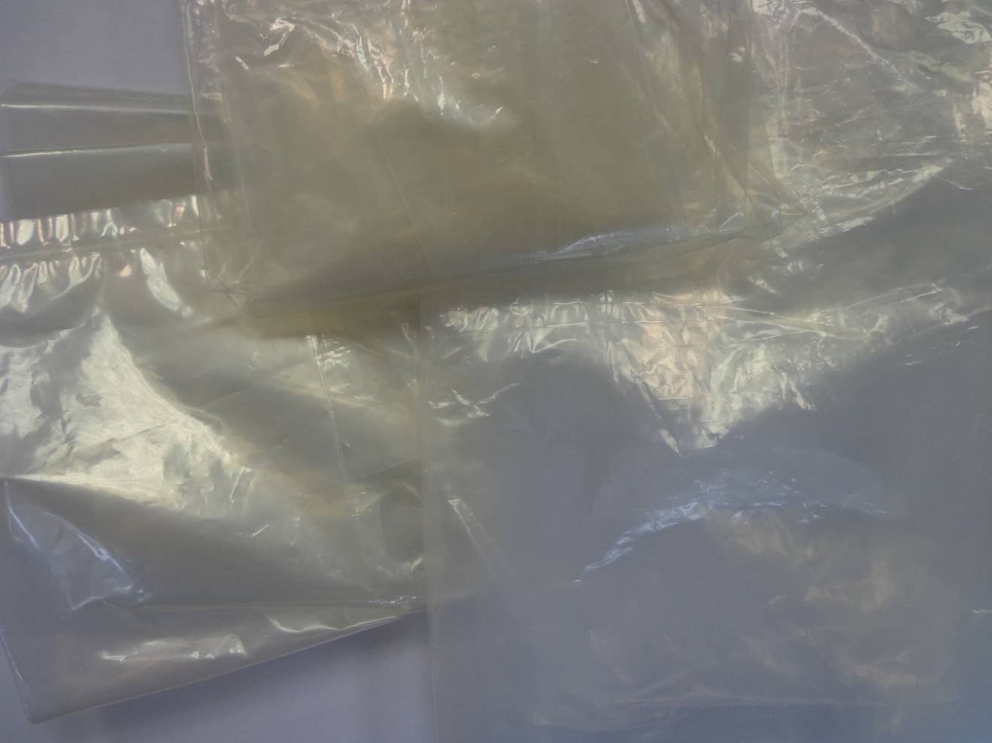
Hydrocyclone + Hot-Wash: Results
15 μm PE film, 100% recycled material, hot wash at 85 degrees C Celsius
Cold washed
Hot washed

Slide 11
PET-Bottles Washing Line

Slide 12
Thank you for your attention!
Our repräsentativ in Spain:
^{COMERCIAL SCHNEIDER, S.A.}
Avda. Cerdanyola nº 98, esc. B, nivel 4, Pta. 17
08173 SANT CUGAT DEL VALLES (Barcelona)
Telf.: 934 763 900-901 Fax.: 934 763 902
^{Movil: 678 608 215}
http://www.comercial-schneider.es//
mailto:alex@comercial-schneider.es

