Slide 1



Zero-waste concepts and circular economy
Klaus Fricke and Burkart Schulte
https://teach4waste.com/
www.creed-ev.de
Information program & B2B-Opportunities, 22-24- Sept 2020

Slide 2
Waste measures hierarchy in EU and Germany
Avoidance
Re-Use
Recycling
Increase of GHG credits
Energy Recovery
Increasing GHG emissions
Resource efficiency
Treatment before landfill
Controlled Landfill with Methane Collection and Energy Use
Controlled Landfill with
Methane Collection and Methane Flared
Uncontrolled Landfills / Dumps

Slide 3
Waste hierarchy
- Circular economy
Avoidance
Re-Use
Recycling
Increase of GHG credits
Energy Recovery
Increasing GHG emissions
Resource efficiency
Only renewable waste components
Treatment before landfill
Controlled Landfill with Methane Collection and Energy Use
Controlled Landfill with
Methane Collection and Methane Flared
Uncontrolled Landfills / Dumps

Slide 4
Why?
Can this objective be achieved in the short term?

Slide 5

Why…
no landfilling?

Slide 6
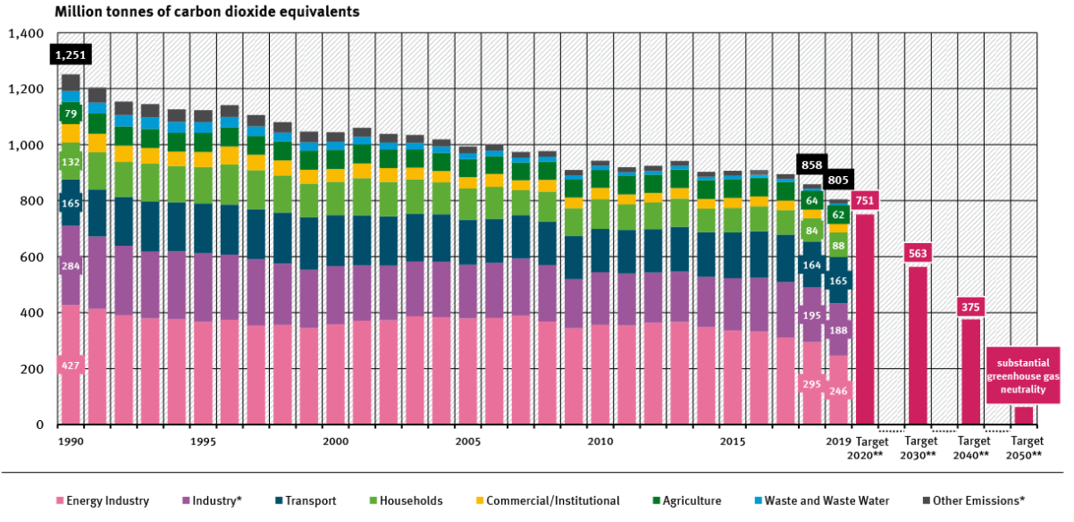
Mitigation of GHG emissions in Germany by waste management
Development GHG emissions in Germany 1990 - 2019
59 Mt CO₂eq of reduction are achieved through waste management measures
Δ= 446 Mt CO₂eq
10 t/capita*a
Source: UBA, 2020

Slide 7
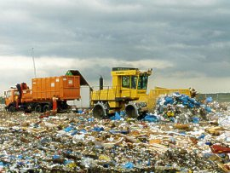

GHG emissions from landfills
- Sources
Gas collection rates in Germany: << 45 % !!!

Slide 8
GHG emissions from landfills
- Germany and the developing countries
In developing countries, GHG emissions from landfills are 1.4 - 1.7 times higher due to the higher proportion of readily degradable organic substances
8 - 12 % of GHG emissions in developing and emerging countries come from the waste sector!

Slide 9
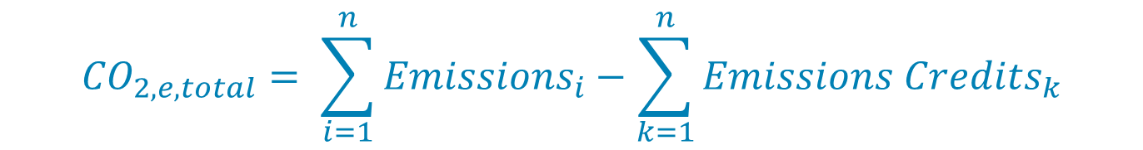
Mitigation of GHG emissions
- Methodology
The total effect of waste management measures results from the sum of GHG credits and GHG emissions:
$${CO}_{2,e,total}= \sum_{i=1}^{n}{{Emissions}_{i}}−\sum_{k=1}^{n}{{Emissions Credits}_{k}}$$
GHG mitigation in Germany from the sector of waste management from 1990 up to 2018:
By GHG emissions (> 90 % landfill based) 38 Million t CO₂ -eq/a
By GHG credits through recycling and energy recovery 30 Million t CO₂ -eq/a
GHG avoidance to date through waste management measures
0.85 t CO₂ -eq/person*a
Sourcee: Modified after UBA 2018

Slide 10
Why…
no landfilling?

Slide 11
Reality
- Current limits of performance

Slide 12

Mass flow MSW
- Germany 2016
100 %
MSW 44 Mio t
66 % Separate collection
60 % Recycling
Recycling
40 % ?
40 % treatment IC and MBT
Treatment before landfill
< 10 % landfill

Slide 13
Can this objective be achieved in the short term?

Slide 14
Need of efficiently recycling technologies

Slide 15
Using AF in the cement manufacturing

Slide 16
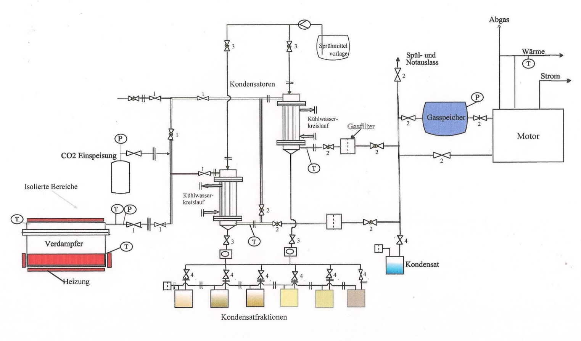
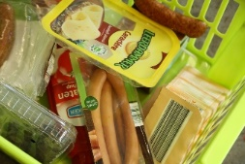
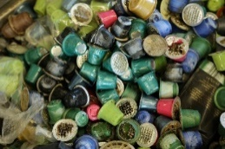
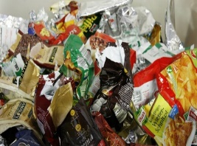
Thermal separating of composite material
– E.G. Discontinuous process by ReSet GmbH
Depolymerisation
CHP
Vaporiser
Source: ReSeT GmbH
www.reset-waste.com
Converter
Fractionated Condensation

Slide 17
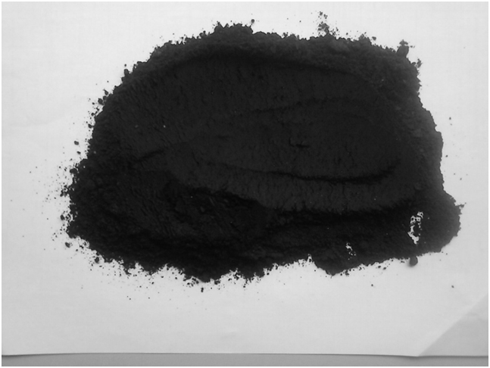
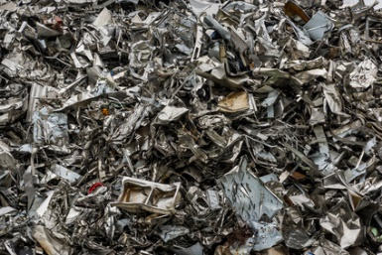
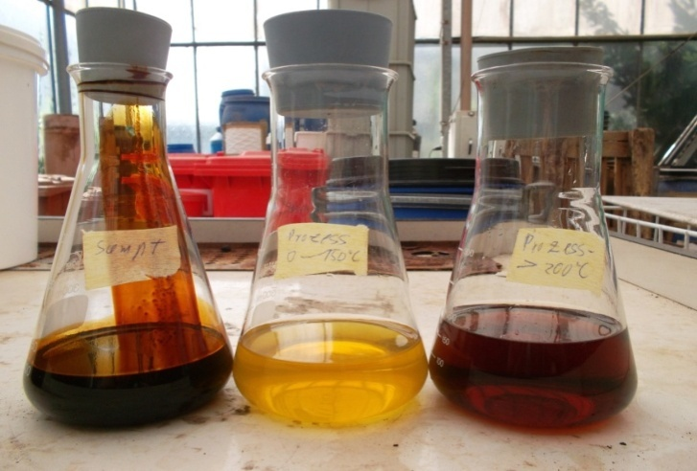
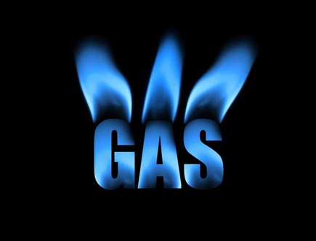
Thermal separating of composite material
– E.G. Discontinuous process by ReSet GmbH
Depolymerisation
CHP
Vaporiser
Source: ReSeT GmbH
www.reset-waste.com
Converter
Fractionated Condensation
Char
Metals
Oil

Slide 18
Perspectives and Tasks
REAL activities for avoidance and reuse
Optimization of transportation and collection
Increase of separate collection
Intensification of sorting of rejects (waste after separate collection)
Increase energy efficiency, digestion and energy recovery
Development of new efficiently technologies
Capacity building

Slide 19




teach4waste international e-learning platform for sustainable waste management
https://teach4waste.com/

Slide 20
Recycling
- GHG credits
Credits in ton CO₂-eq per ton recycling material
Source: regarding to Öko Institut, 2018

