Slide 1
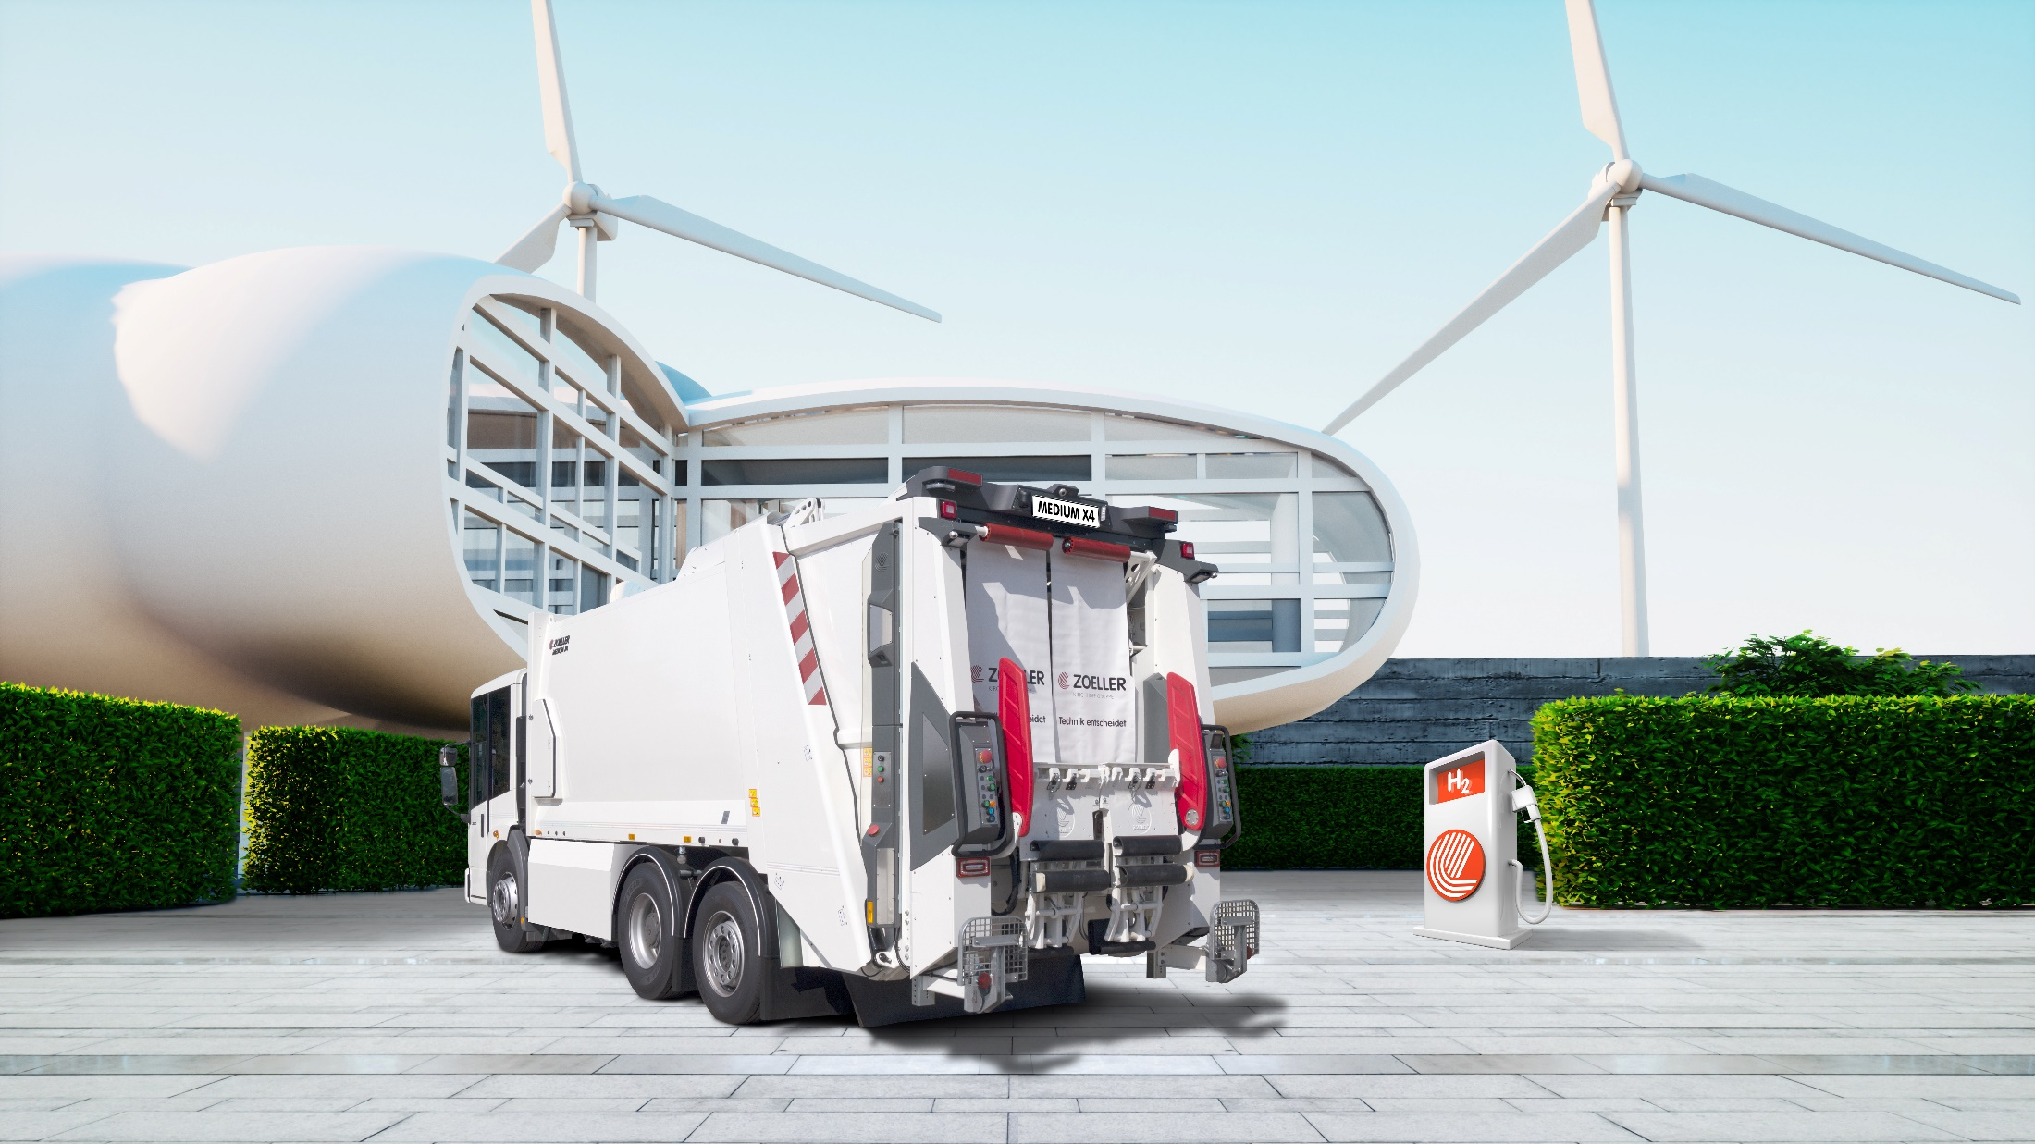

BLUEPOWER CLEAN DRIVE

Slide 2
BLUEPOWER CLEAN DRIVE
BLUEPOWER CLEAN DRIVE
is the future of emission-free
waste disposal.
ZOELLER will put the hydrogen fuel-cell driven, fully-electric refuse collection vehicle in the market in 2020.

Slide 3

BLUEPOWER CLEAN DRIVE
100 % clean
CO₂-, NOx- free
less particulate matter
very quiet
Notes:
Verpassen Sie deshalb nicht Ihre Chance, bei den Vorreitern zu sein und das Thema Ökologische Verantwortung im Sinne der Corporate Responsibility für sich zu besetzen.

Slide 4

BLUEPOWER CLEAN DRIVE
Clean Drive
is our answer to „Dieselgate“
  Clean Drive
  Protects waste-disposal-service providers from driving bans
  Clean Drive
  reduces all emissions (CO2, nitrogen oxides, particulate matter)
  Clean Drive
  is quiet and almost noiseless
  Clean Drive
  gives cities, municipalities and waste disposal companies the opportunity to set a good example

Slide 5
What is BLUEPOWER?
BLUEPOWER is …
… an emission-free drive
for refuse collection vehicles.
Modular design, with safe
hydrogen fuel-cell technology.
BLUEPOWER is …
… a fully electric chassis.
To achieve and exceed the range of a vehicle with conventional drive technology, we use HYDROGEN.

Slide 6
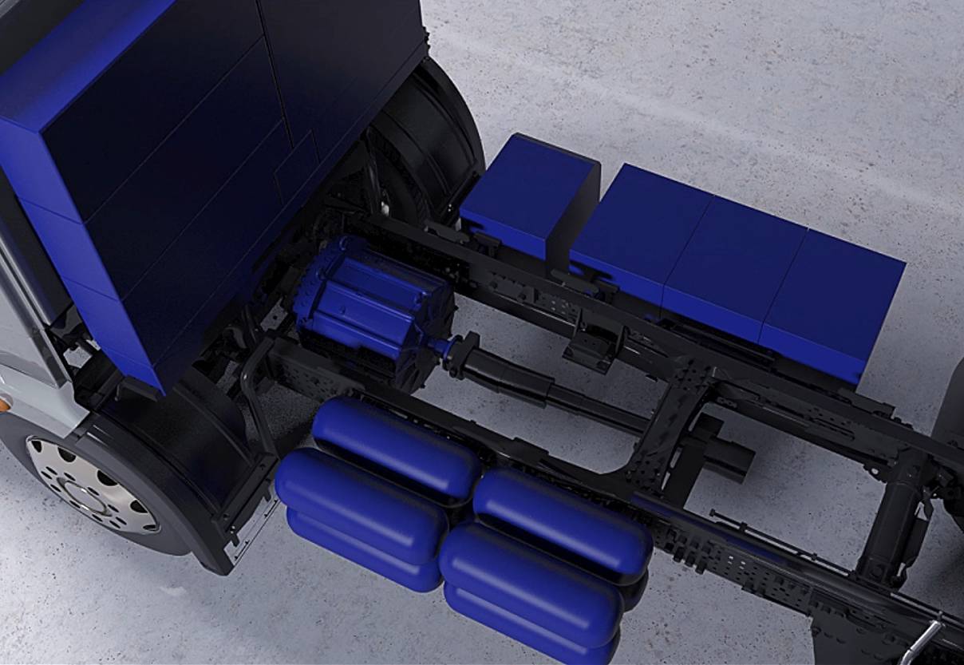
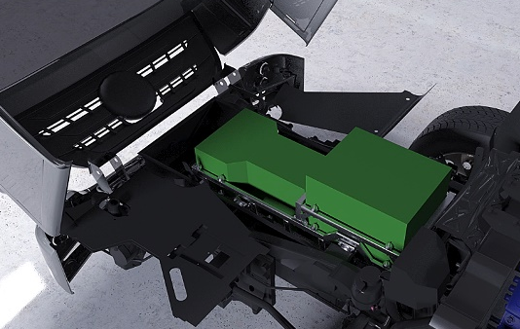
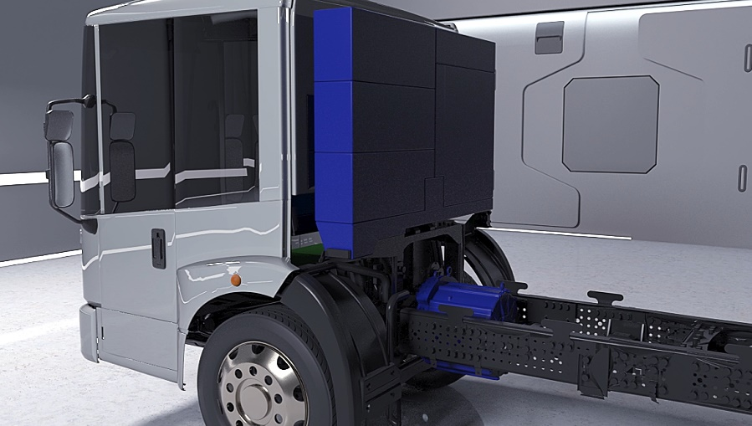
Construction BLUEPOWER
In a chassis without conventional drive (glider) we insert all necessary BLUEPOWER-components :
Battery module
On-Board Charger
Electric drive
Fuel cell
Steering-unit, cooling elements and high-voltage-distributor
Hydrogen tanks
Charger CCS 2.0

Slide 7
Construction BLUEPOWER

Slide 8
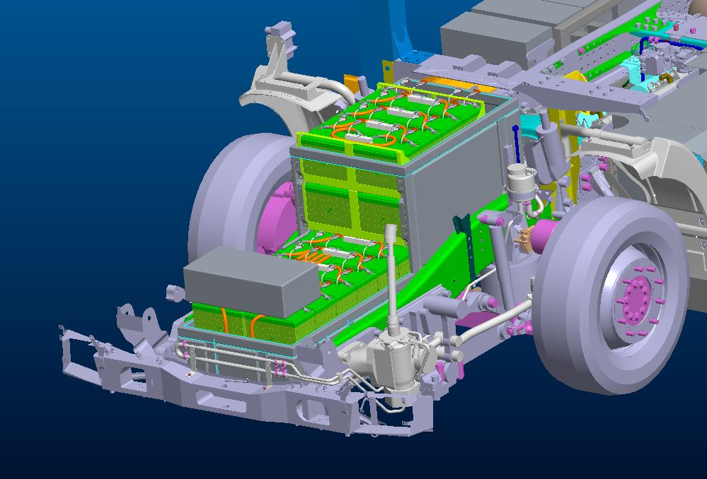
Components BLUEPOWER
The chassis without conventional drive components (glider) will be completed with BLUEPOWER-components :
Battery package:
Battery capacity: 85 kWh
Collection performance : 2 x ca.10 t waste
Range: 20 km Transport & collection
Charging time: 40 min fast charging
Chemistry: NMC

Slide 9
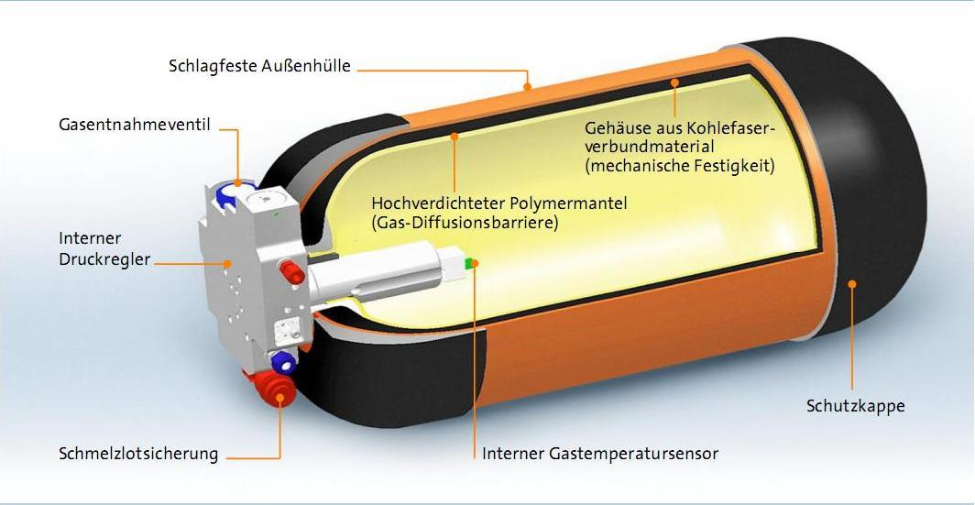
Components BLUEPOWER
The chassis without conventional drive components (glider) will be completed with BLUEPOWER-components :
Fuel cells:
Fuel cell: 30 / 60 / 90 kW
Hydrogen storage:
Storage: 100 kWh – 400 kWh
Pressure: 700 bar
Refuel time: appr. 3-15 minutes
Range: up to 400 km

Slide 10
Advantage through production step
Directly starting production
No demounting work has to be done (Diesel engine, exhaust system, …)
Since no gearbox is installed, recuperation possible!
Delivery of glider by Mercedes Benz as OEM, therefore well known equipment (e.g. cab accessories, axle, break..)

Slide 11
Hydrogen as an energy carrier
Advantage BLUEPOWER:
Battery electric vehicles are limited in point of range.
Fuel cells and hydrogen storage tanks are in modular structure. 12 configurations.
Thanks to the high energy density of hydrogen and the significantly lighter components, we achieve a higher level of efficiency.
The Bluepower assembly is equipped according to the requirements and is weight optimized.
Short charging time, hydrogen can be refuelled in a few minutes.
Ranges up to 400 km are possible, depending on operation conditions.

Slide 12
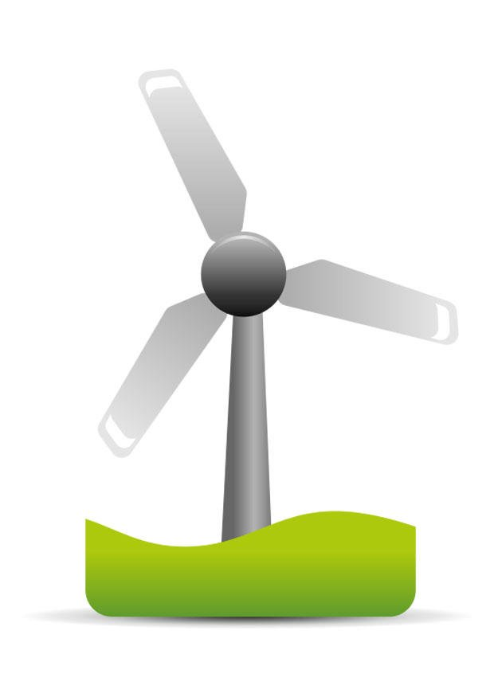

Hydrogen process
Hydrogen is produced by electrolysis of water.
Hydrogen must be produced from green energy (wind, solar, ...).
Or in incineration plants it is possible to produce hydrogen with simple means.

Slide 13
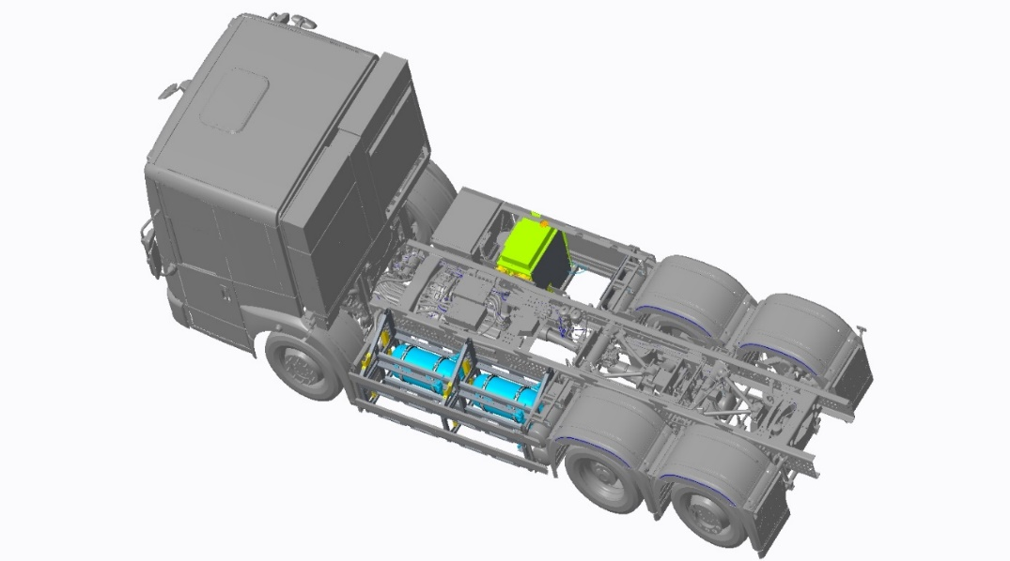
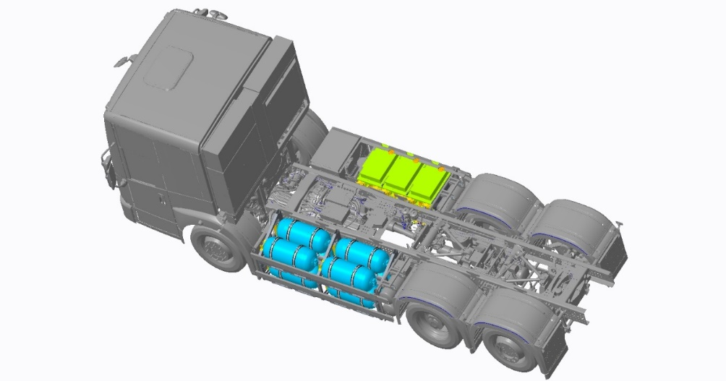
Bluepower examples
1 fuel cell and 1 tank group (4,2 kg H₂)
3 fuel cells and 4 tank groups (16,8 kg H₂)

Slide 14
BLUEPOWER CLEAN DRIVE
1 - Support of ZOELLER to define the product corresponding to the needs of the operation
2 - Assembly and supply of an electric chassis with a hydrogen range extender
3 – Assembly and supply of a ZOELLER body with automatic lifter
4 - Connected equipment, with regular analysis of information and remote updates

Slide 15
Thank you for your attention

